Slide 1
Stereoscopy in Ogre3D
Helgi Leifsson
Reykjavik University
April, 2013

Slide 2
Motivation
Multiple technologies converging to make cheap and effective Head-Mounted-Displays possible
Gyroscopes, accelerometers, magnetometers, high density mobile displays all very small and cheap
Powerful GPU’s and CPU’s for believable 3D environments

Slide 3
Related Work
W. Robinett, J. Rolland; A Computational Model for the Stereoscopic Optics of a Head-Mounted Display; University of North Carolina; USA; 1991
Oculus VR Inc.; Oculus SDK Documentation; March 2013

Slide 4
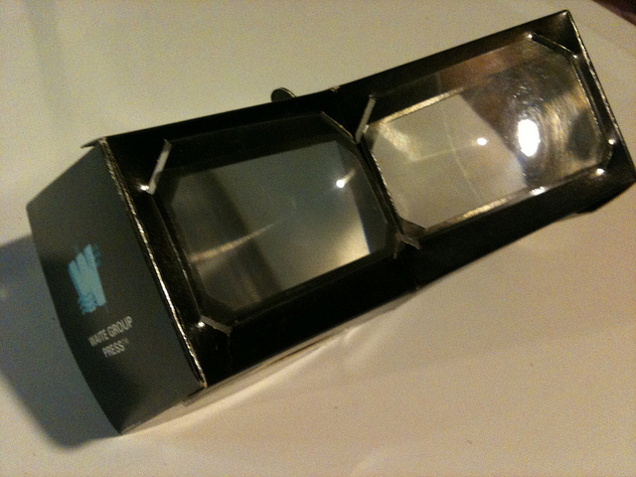
My Solution

Slide 5
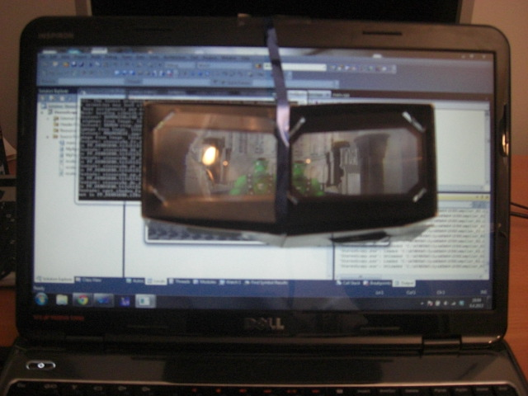
Test Setup

Slide 6
My Solution
Two viewports
Two cameras
Custom projection matrix using measurements of the fresnel lenses
Shifting the cameras horizontally each frame using view matrices for stereo
No distortion at this stage

Slide 7
Future Work
Single pass culling
Reprojection

